Slide 1
ApPLYING THE SHAPLEY VALUE REGRESSION METHOD TO MARKETING RESEARCh
Case Study : Customer Satisfaction Survey
Under the supervision of:
P. Blanchard
Realized by:
Tam Dan VU
Master 2: MASERATI
University of Paris Est Creteil
Under the direction of Mr. P. Blanchard.
Directed by:
Cherifi Lydia & Vu Dan
Master 2: MASERATI

Slide 2
PLAN
INTRODUCTION
MULTICOLLINEARITY and OLS REGRESSION
SHAPLEY VALUE REGRESSION
CONCLUSION

Slide 3
I. INTRODUCTION
Database of Customer Satisfaction Study of SNCF
Advantages
Limits
- Measurement is simple to visualize in real-time
- Versatile/ variety of questions
- Detailed analysis / different criteria
- Focus in a specific interaction
Overall rating/without detail on the experience.
- No projection into the future

Slide 4
Variables in our study
4 Categories
Information
Transfer
Cleanliness and security
Comfort
Q1a - Orientation in the station
Q2 - Transfer to and from the platform
Q3a - The cleanliness of the station
Q3a -The comfort of waiting in the station
Q1b - Ease of finding information
Q3b - The security of the station
Q3b - The time spent in the station
Q1c - Ease of locating the services available
Q3c - The cleanliness of the toilets in the station
Rank the scores, on a scale of 10:
1 to 6 → Detractor
6 to 7.5 → Neutral
>= 7.5 → Promoter

Slide 5
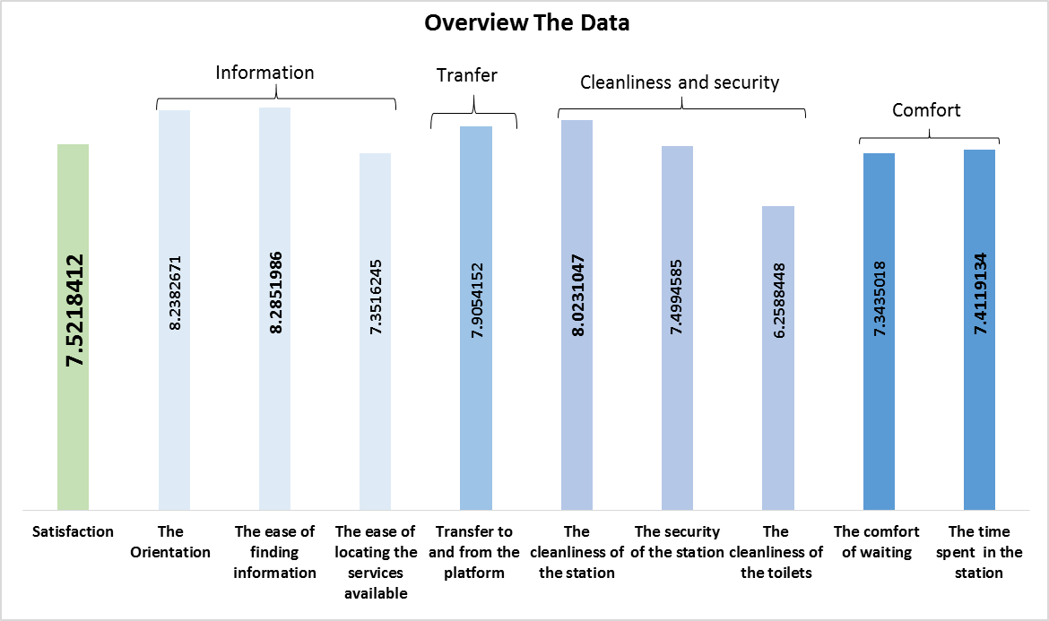
Overview data
Average of information:
7.96
Average of Transfer
7.90
Average of Cleanliness & Security:
7.26
Average of Comfort:
7.34

Slide 6
II. MULTICOLLINEARITY AND OLS REGRESSION
Multicollinearity
Examination of Correlation Matrix
Variance Inflation Factor
Eigensystem Analysis of Correlation Matrix

Slide 7
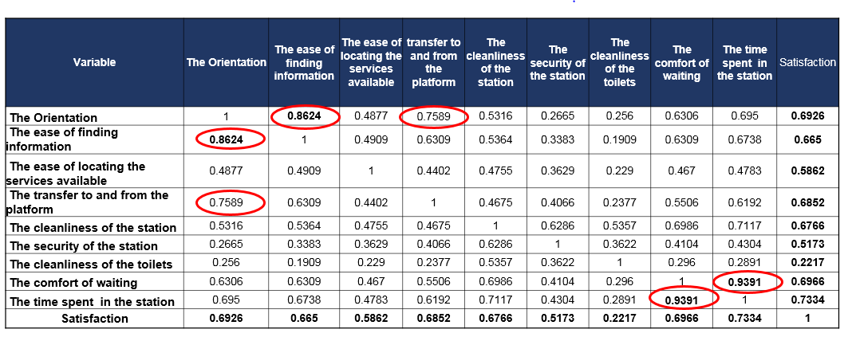
Correlation Matrix

Slide 8
Variance Inflation Factor (VIF )
Eigensystem Analysis
→ Presence of multicollinearity

Slide 9
OLS Regression
- All other things being equal, at the 5% threshold:

Slide 10
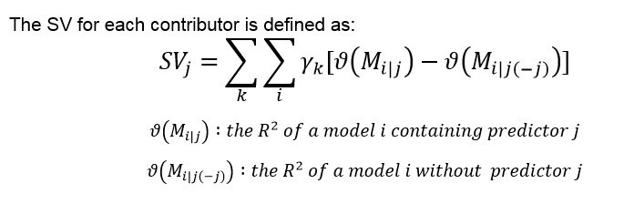

III. SHAPLEY VALUE REGRESSION
Formula
$γ_{k}= \frac{k!\left(n−k−1\right)!}{n!}$

Slide 11
Methodology of SVR

Slide 12
Comparison between OLS and SVR

Slide 13
Results of SVR

Slide 14
CONCLUSION

